Slide 1
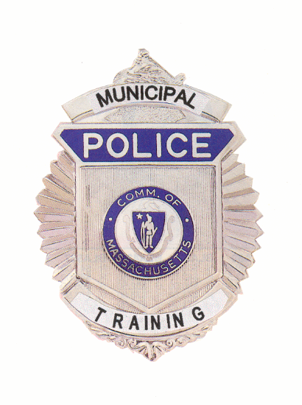
RESERVE INTERMITTENT
RECRUIT FIREARMS PROGRAM
Commonwealth of Massachusetts
Municipal Police Training Committee

Slide 2
MPTC RESERVE OFFICER FIREARMS TRAINING COMMITTEE
SGT William Leanos, Firearms Training Coordinator
Officer Todd Bailey, Officer Joseph Picariello, Officer Ron Raneri, Officer Stephen Taranto & Chief Bert DuVernay
February 2011

Slide 3
SAFETY
Safety is paramount in this program
Safety is everyone’s responsibility
Safety protocols for on & off the range

Slide 4
SAFETY
Cardinal Rules of Firearms Safety
Designed to reduce the likelihood of an unintentional discharge
- and should one occur, to minimize the potential for injury
Modern firearms only discharge if the trigger is pressed.
- It will not “go off by itself”

Slide 5
CARDINAL RULE #1
Treat ALL firearms as if they were loaded - ALWAYS
Operative word is “always”
Applies even if you have personally checked that the weapon is unloaded

Slide 6
CARDINAL RULE #2
Never point the weapon at anything you do not intend (or are willing) to shoot.
Keep the muzzle pointed in a “safe direction”
- defined as a direction which, if the weapon should fire, the round would not cause an injury and only minimal (if any) property damage

Slide 7
CARDINAL RULE #2
“Down range”
“Low Ready”
“Muzzle Discipline”
Extremely important when moving tactically on the range

Slide 8
CARDINAL RULE #3
Keep your finger OFF the trigger until you are on target AND have made the decision to fire.
Finger stays indexed along the frame well outside the trigger guard
Finger comes OFF the trigger when
- not actively engaging a threat
- scanning for additional threats
- holstering the weapon

Slide 9
CARDINAL RULE #4
Know your target and what is beyond it.
We are morally obligated to identify what we are shooting at before we use deadly force
- Use of flashlight in reduced light
- We do NOT shoot at sounds
If you miss, what is behind it?
- Innocent bystanders???

Slide 10
CARDINAL RULE #4
If you miss your target, where does that bullet go?
Straight to court!!

Slide 11
Safety in the Home
Mass Safe Storage Law
- MGL c.140 s.131L
- No exemption for Law Enforcement
Prevent access by “unauthorized” persons
- Children
- Unlicensed adults
- “Prohibited persons”
- criminal / medical reasons

Slide 12
Transporting Firearms
Transporting firearms in vehicles
- MGL c.140 s.131C
- Exemption for Law Enforcement IF in the line of duty
Unloaded
Locked container

Slide 13
Range Safety
Read & sign Range Safety Rules form
You are responsible for understanding and abiding by the Range Safety Rules
Violations of any safety rule is grounds for disciplinary action
Range commands and what they mean
Range safety equipment

Slide 14
Use of Force
      The Totality Triangle®
Perceived Circumstances
Perceived Subject Actions Reasonable Officer Response

Slide 15
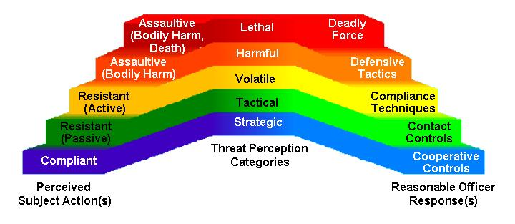
Use of Force
Reference Guide

Slide 16
Case Law Review
Tennessee v. Garner
- Deadly force on fleeing felons
Graham v. Connor
- Objective Reasonableness
Commonwealth v. Klein
- Use of Deadly Force by citizen
Julian v. Randazzo
- Use of Deadly Force by police

Slide 17
Nomenclature

Slide 18
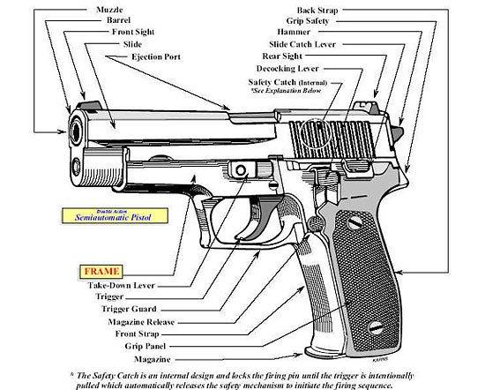

Slide 19
Function

Slide 20
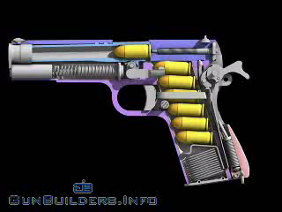
Animation will start automatically

Slide 21
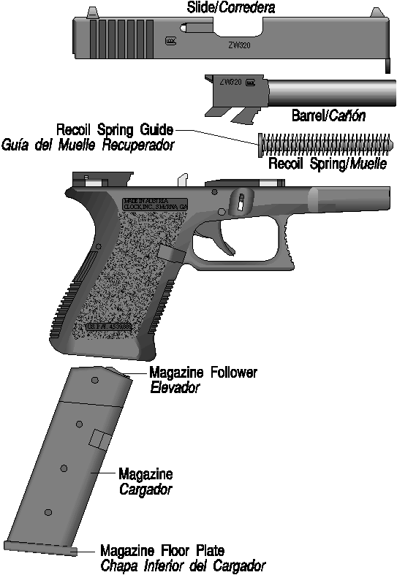
Field Stripping your duty pistol for inspection and maintenance

Slide 22
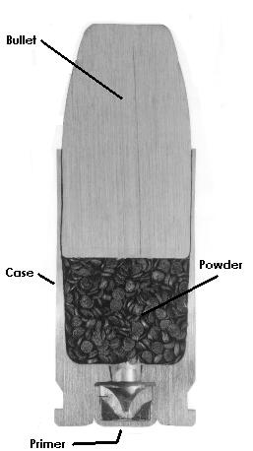
Ammo Components

Slide 23
Duty Belt Set Up
Nothing positioned over or near spine
Wear holster on point of hip or just slightly forward for easier draw
Important equipment accessible with either hand
Magazine pouch positioned for smooth draw
Some magazine pouches can be positioned either horizontal or vertical

Slide 24
Duty Belt Set Up
Index magazines so bullets point towards belt buckle
- All magazines indexed the same
Positioning should make ‘tactical sense’
- Smooth access
TASER (if authorized) carried cross draw

Slide 25
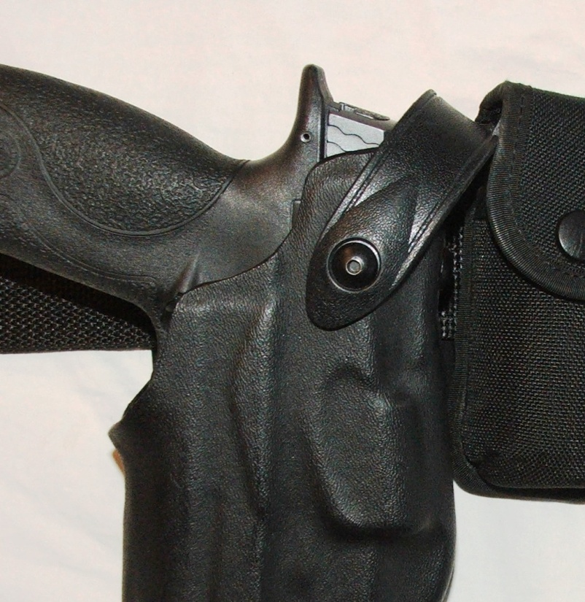
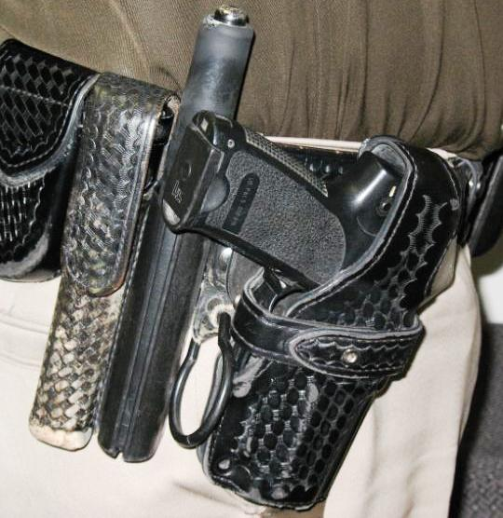
Duty Belt Set Up
Position equipment so it does not interfere with holster operation. Use keepers!
Examples of what NOT to do!

Slide 26
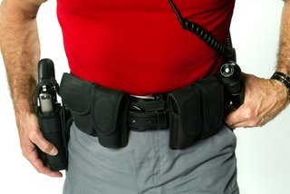
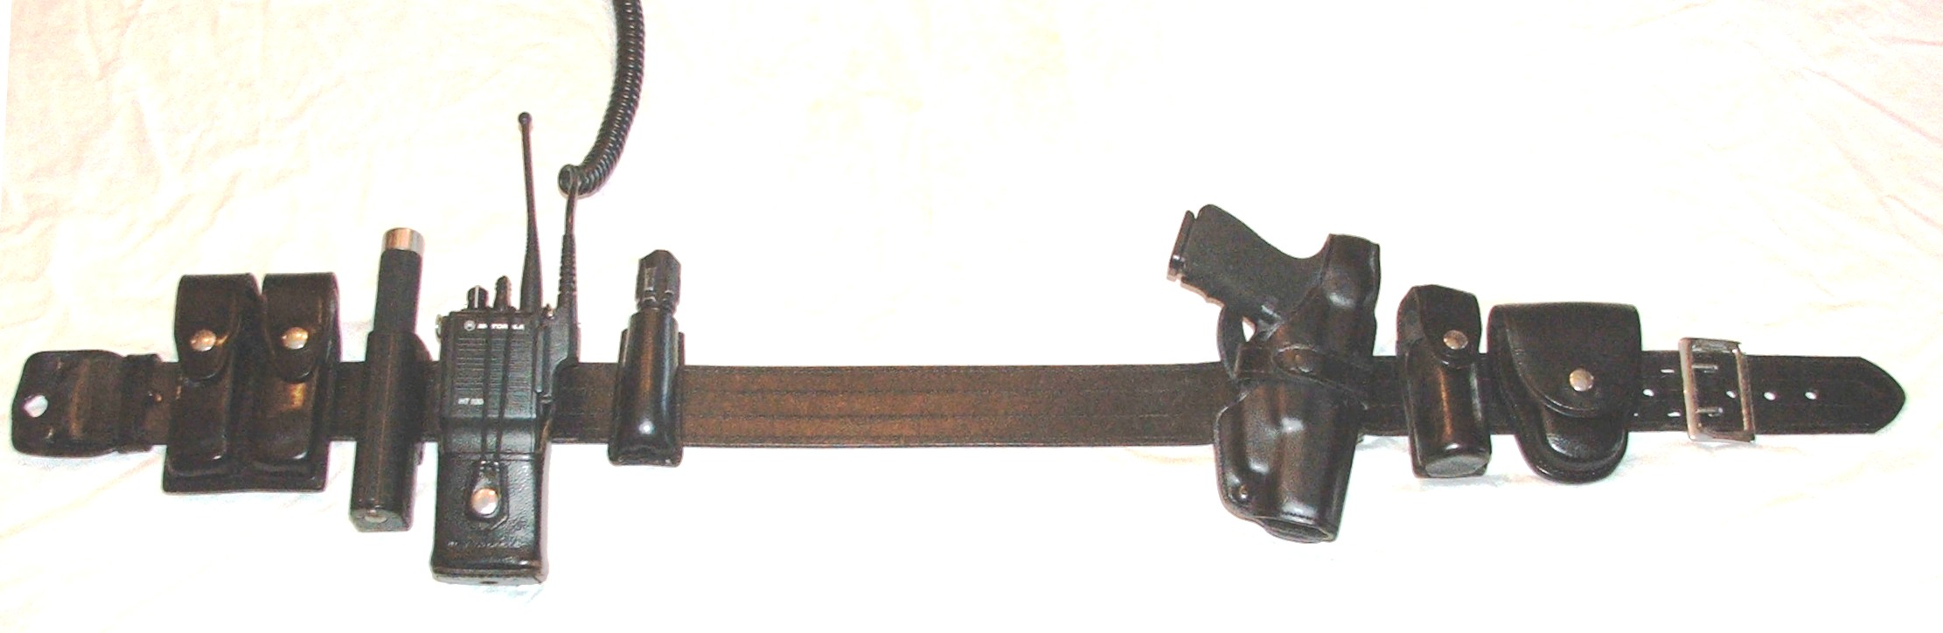
Duty Belt Set Up

Slide 27
Duty Belt Set Up
Right Handed Shooter (reverse for left handed)
One example of many possibilities
FRONT
BACK
Magazine Pouch
TASER
Baton
Portable Radio
Flashlight
Handcuff Pouch
OC
Holster
NOTHING HERE

Slide 28
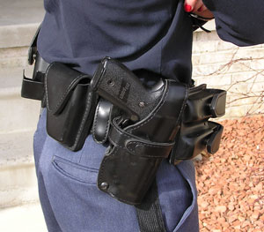
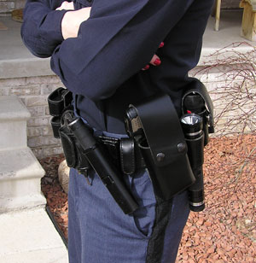
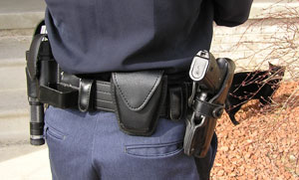
Duty Belt Set Up
Some officers with smaller waists may find it challenging to find a place for all the equipment they are required to carry.
NOT RECOMMENDED!

Slide 29
Duty Gear
Leather, Nylon or Synthetic Hybrid
Routine maintenance
- Clean it
- Lubricate snaps (if present)
- Inspect it
Replace if broken, torn, worn, stretched or otherwise does not securely hold the piece of equipment

Slide 30
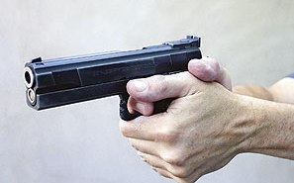
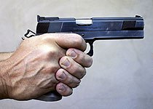
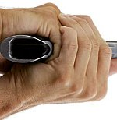
Preferred Grip
2 Hand wrap around grip with thumbs forward.

Slide 31
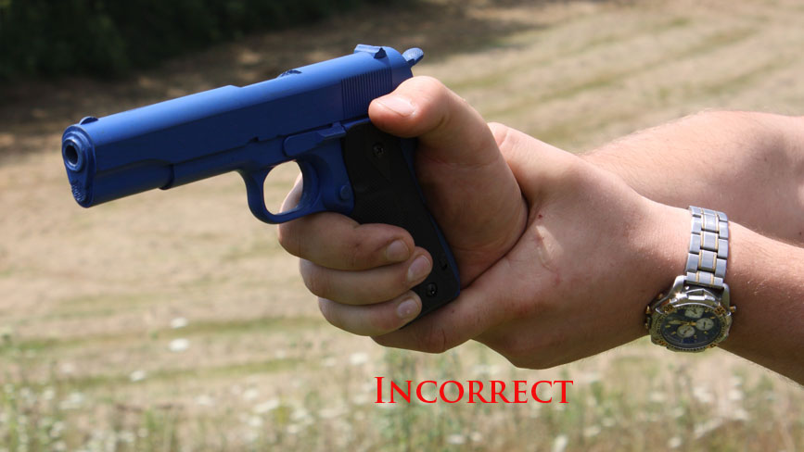
AVOID THIS

Slide 32
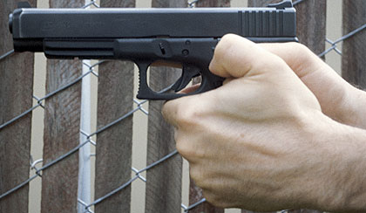
AND THIS

Slide 33
Five Steps of Draw
Grip
The shooter establishes the proper
with the trigger finger extended straight
down alongside the holster.
As the grip is established, the shooter
deactivates any manual retention devices.
The support hand remains at mid-chest.

Slide 34
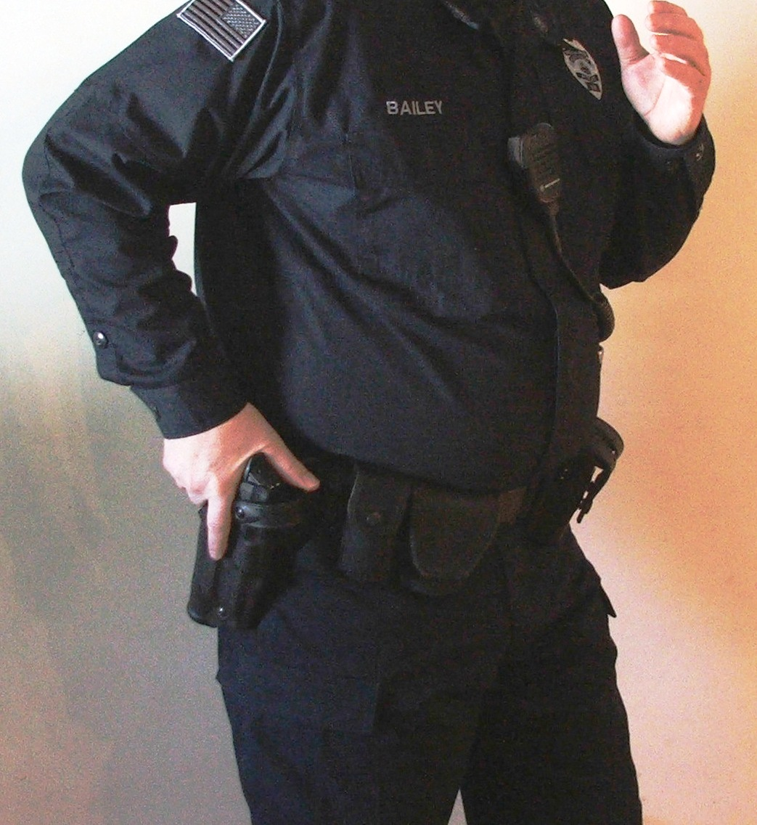
Five Steps of Draw
Grip

Slide 35
Five Steps of Draw
Draw
The shooter draws the pistol out of the holster until the muzzle is just clear of the
holster.
If necessary, take any actions required to
clear any retention devices such as rocking or twisting the pistol.
The support hand remains at mid-chest.

Slide 36
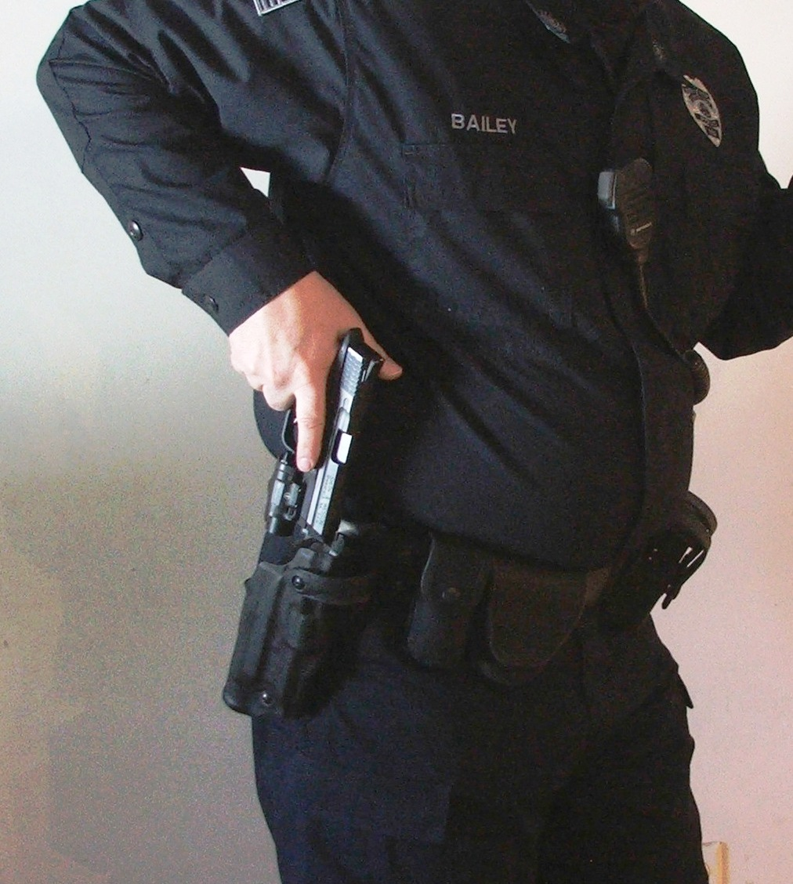
Five Steps of Draw
Draw

Slide 37
Five Steps of Draw
Rotate
Rotate the pistol so the muzzle points towards the threat (target). This is best
done by dropping the elbow. The muzzle
will automatically point where it needs to.
This puts the pistol in the “hip shooting” position suitable for close in deadly force
encounters. The pistol may be fired from this point on.
The support hand remains at mid-chest.

Slide 38
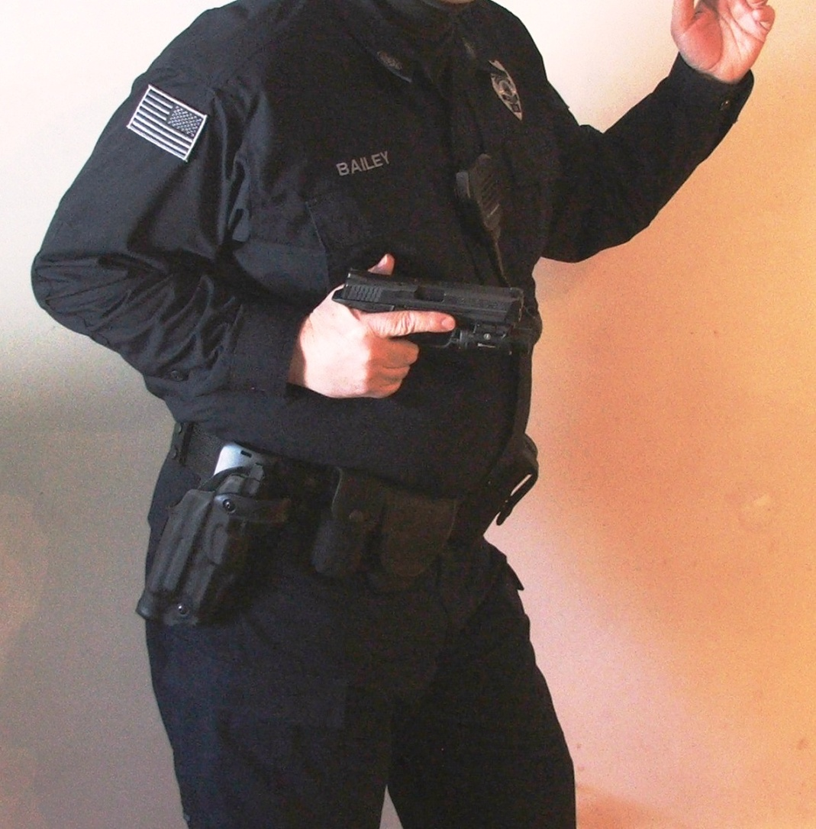
Five Steps of Draw
Rotate

Slide 39
Five Steps of Draw
Together
The shooter brings the pistol to the midline of the body at mid-chest level as the support hand comes together to establish the proper two hand grip.

Slide 40
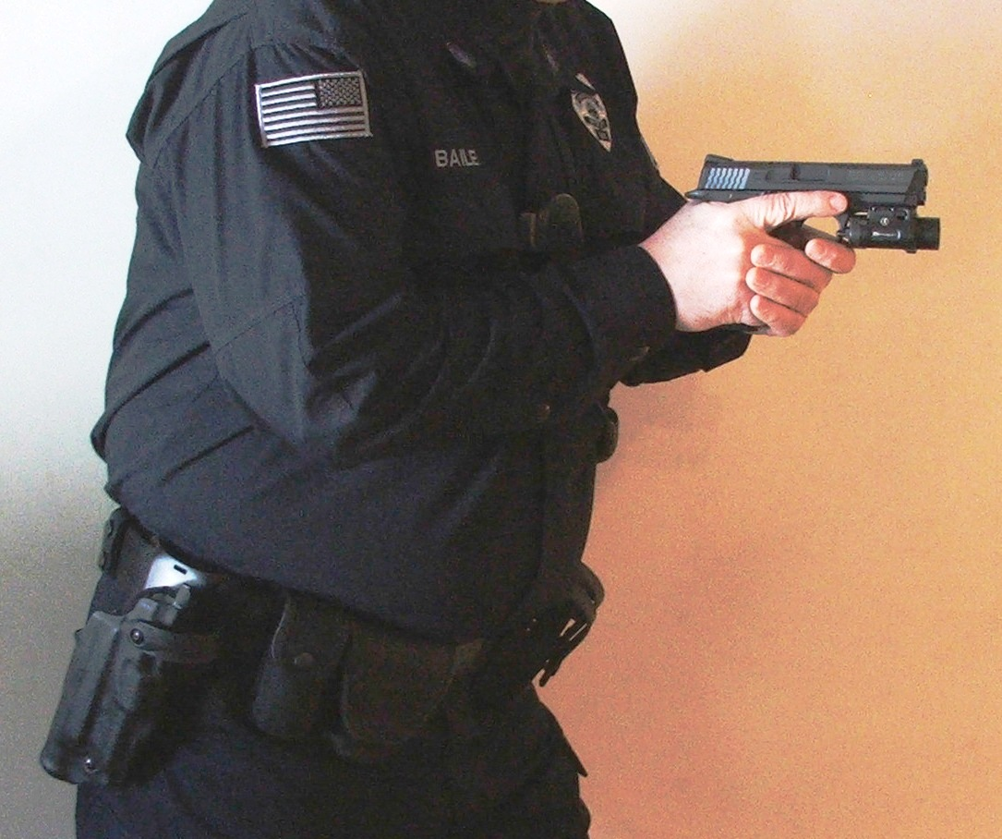
Five Steps of Draw
Together

Slide 41
Five Steps of Draw
Up
The pistol is brought up to eye level and the shooter obtains his/her sight picture.
NOTE: Until the officer has made the decision to shoot, their finger remains OFF the trigger throughout all steps of the draw.

Slide 42
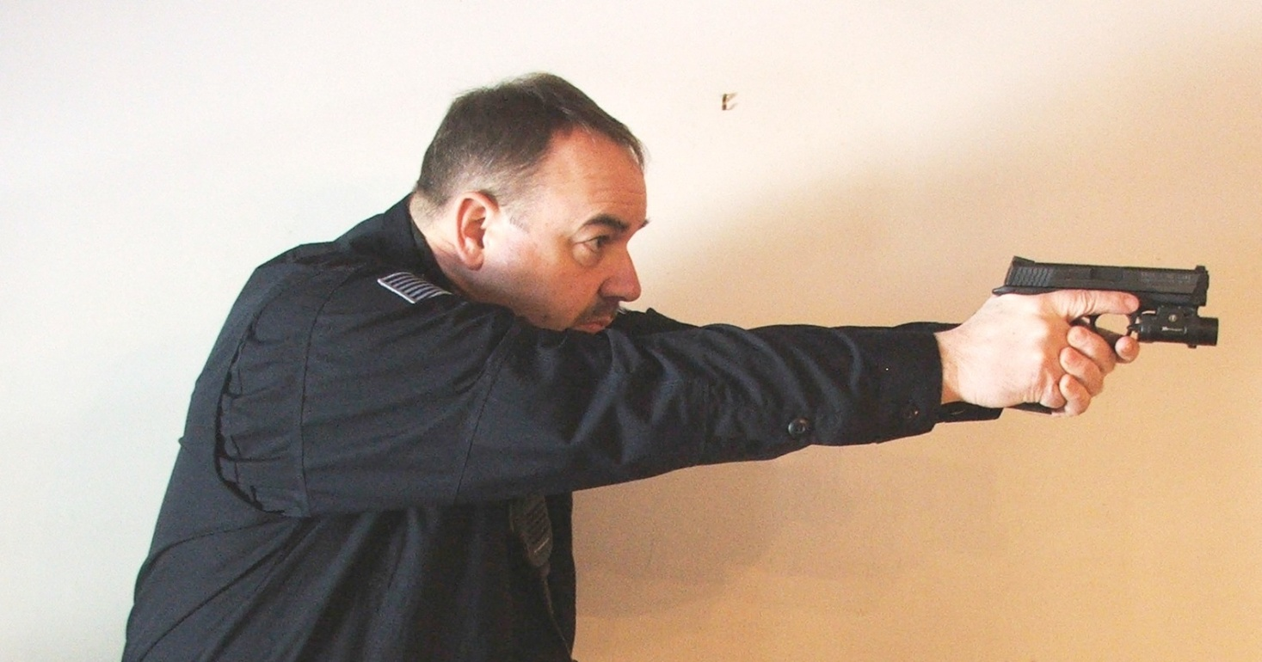
Five Steps of Draw
Up
NOTE: Until the officer has made the decision to shoot, their finger remains OFF the trigger throughout all steps of the draw.

Slide 43
Recovering Back to the Holster
Scan
Scan 360°, any additional threats?
Finger off the trigger
Muzzle discipline. Just swivel your head.
When deadly force is no longer needed, go to the “Low Ready” or the mid-chest “High Ready” position.

Slide 44
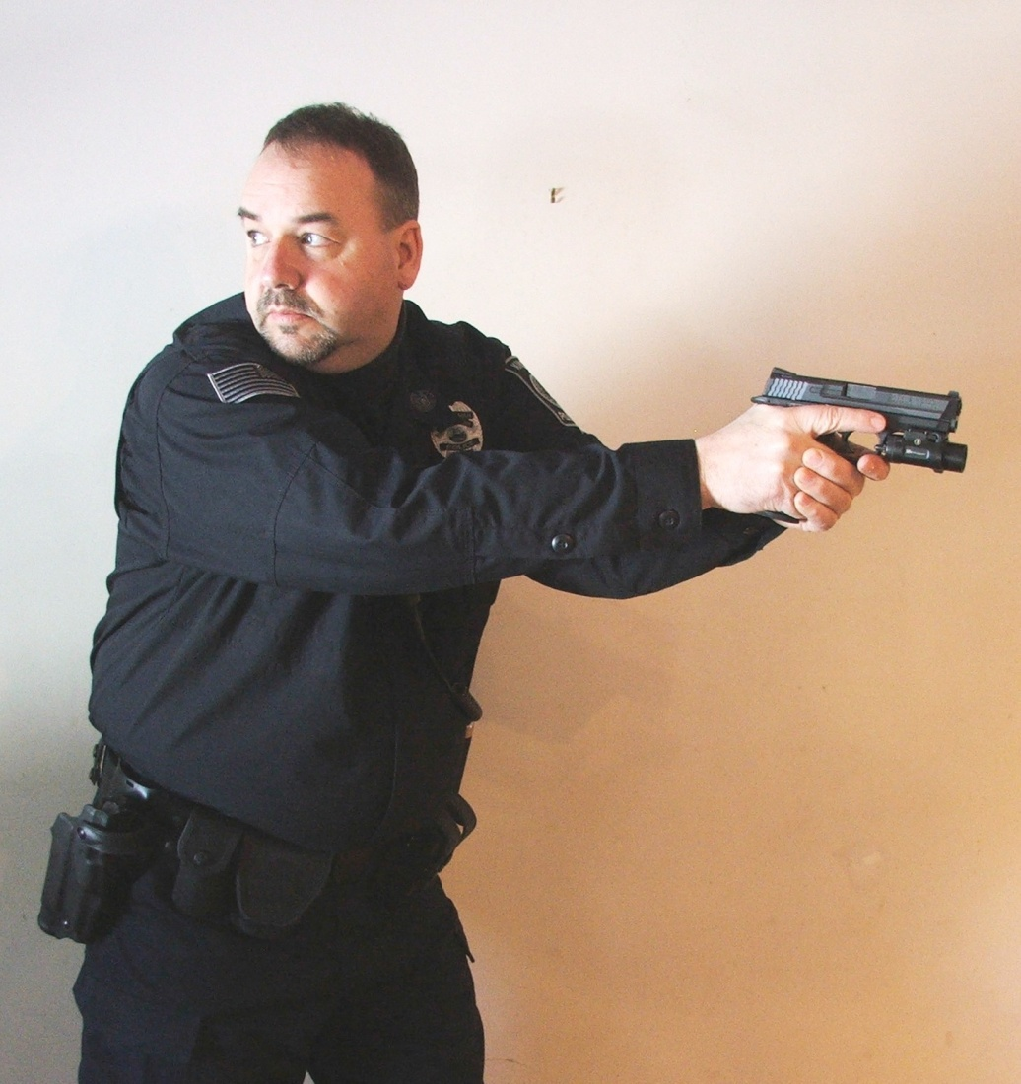
Recovering Back to the Holster
Scan

Slide 45
Recovering Back to the Holster
Breathe
Inhale and exhale slowly a couple of times to get oxygen back into your system. This will begin to bring your heart rate back down.
Scan slowly again for additional threats. Maybe you missed something the first time.

Slide 46
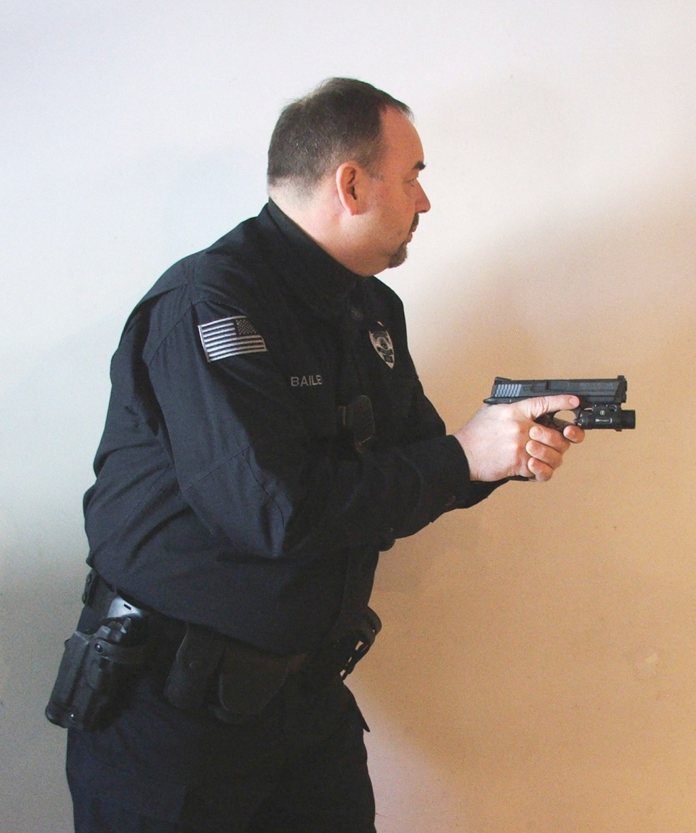
Recovering Back to the Holster
Breathe

Slide 47
Recovering Back to the Holster
Recover
Bring the pistol back to the mid-chest if necessary. The support hand remains at mid-chest in a defensive stance.
Keeping your eyes on the threat. Place your gun hand thumb behind the slide and holster the pistol with one hand.
Snap up all retention devices.

Slide 48
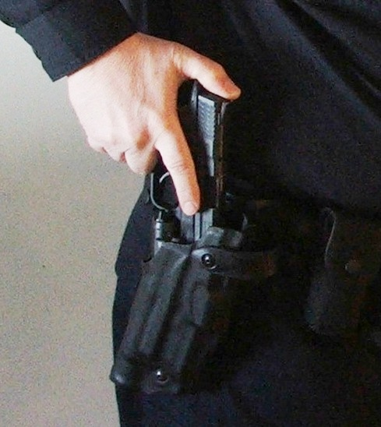
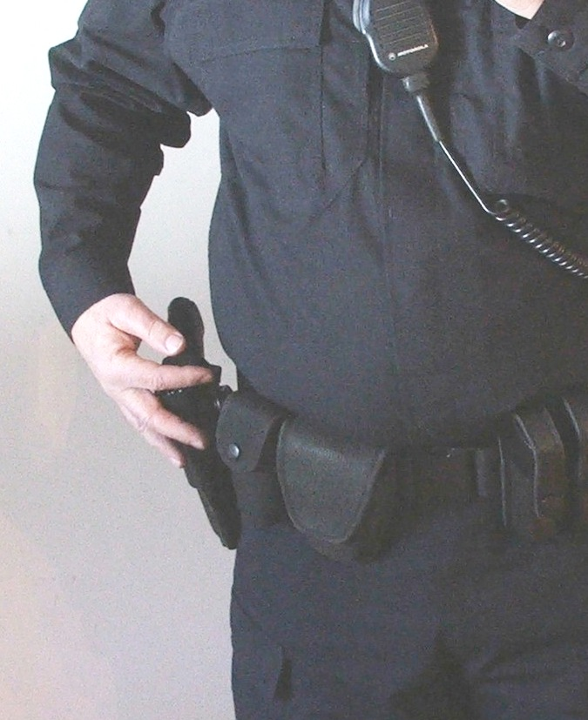
Recovering Back to the Holster
Recover
Secure
&

Slide 49
Recovering Back to the Holster
Don’t rush back to the holster
Don’t put the pistol away until you are 100% sure there are no other threats.
Keep your finger OFF the trigger
Don’t look at the holster
You will get better with practice!

Slide 50
Sight Picture
Front sight in focus
Rear sight and target blurry

Slide 51
Stance
Stance should be balanced and comfortable
Isosceles
Weaver
- Modified Weaver

Slide 52
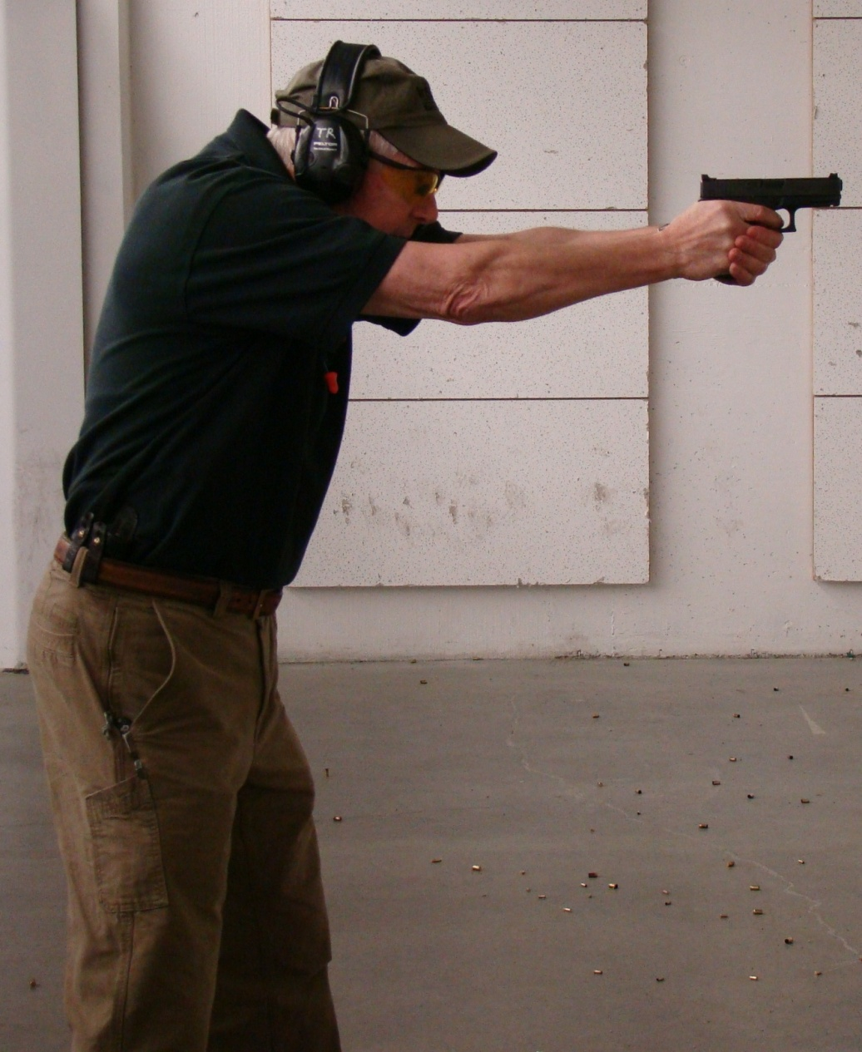
Isosceles
Square to the threat or target
Arms out straight
Elbows locked
Maximizes body armor protection

Slide 53
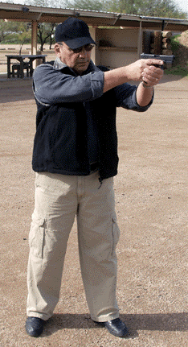
Weaver
Bladed stance toward threat or target
Gun arm straight or slightly bent
Support arm elbow bent

Slide 54
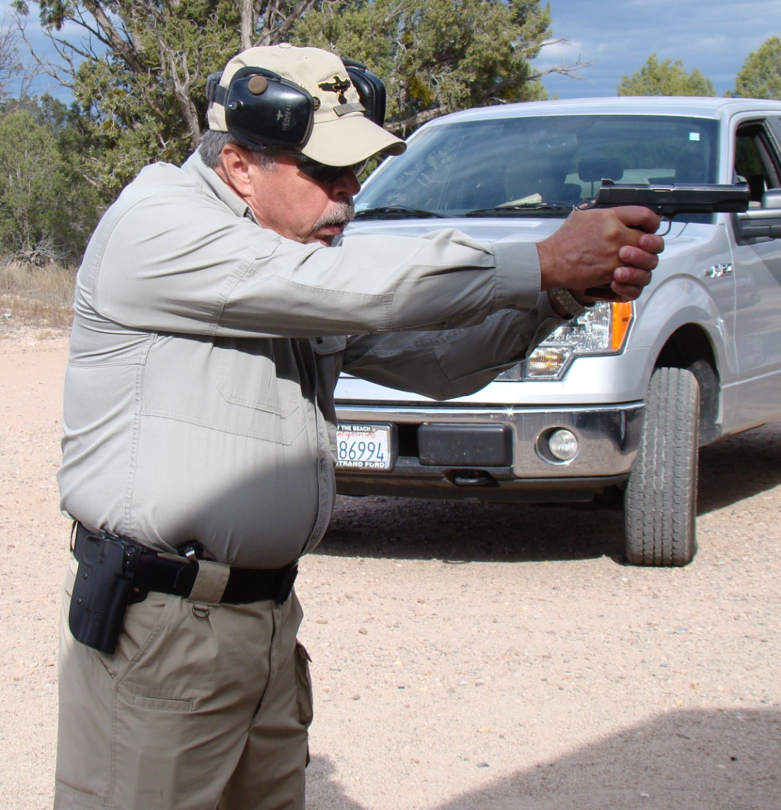
Modified Weaver
Incorporates the best attributes of the Weaver and Isosceles
Torso square to the threat or target
Hips down slightly bladed
Support arm elbow slightly bent

Slide 55
Qualification
MPTC Pistol Qualification Course
50 Rounds
Minimum passing score = 80%
- 40 hits out of 50
Round accountability
3, 5, 7, 10 and 15 yard stages

