Slide 1
Basic Firearms Instructor Course
Municipal Police Training Committee
Firearms Advisory Group

Slide 2
Shotgun Instructor Module Revised April 2012

Slide 3
Authors
Chief Bert DuVernay – New Braintree PD chief@newbraintree.org
Off. Todd Bailey – Kingston PD tabailey@mlefiaa.org
References
MLEFIAA Firearms Instructor Development Program 2007
MCJTC Firearms Instructor Manual 2005
Mass. Sheriff’s Assn. E.T. C. Firearms Instructor Course
NRA Tactical Shotgun Course
Action Target 3 Gun Course (Shotgun)

Slide 4
GOAL
To give the prospective instructor the necessary skills to teach the function, role and limitations of the shotgun in a law enforcement situation.

Slide 5
Student Performance Objectives
Demonstrate safe and proper operation of the shotgun
Identify the basic components of the shotgun and their function
Demonstrate the basic shooting positions used with the shotgun
Describe and demonstrate the proper cycling of the pump shotgun

Slide 6
Student Performance Objects
Describe and demonstrate the proper cycling of the shotgun
Describe and demonstrate mounting techniques with the shotgun
Demonstrate proper loading reloading, downloading and unloading techniques of their shotgun
Demonstrate proficiency by qualifying to MPTC standards

Slide 7
Firearm Safety Rules
Treat all firearms as if they are loaded – ALWAYS
Keep your muzzle pointed in a safe direction at all times
Keep your finger off the trigger until on target and you have made the decision to shoot
Know your target and what is beyond it

Slide 8
Purpose of the Shotgun
To provide the police officer with a versatile multipurpose large bore weapon capable of safely engaging targets beyond the typical range of the service pistol.

Slide 9
Is the shotgun obsolete?
No!!
It is arguably the most versatile weapon in our inventory

Slide 10
Police Shotgun Munitions
Single projectile (slug)
Multiple projectile (buckshot)
OC
Distraction devices
Breaching
Bird shot
Single projectile impact munitions
Multiple projectile impact munitions
Tear gas

Slide 11
Combat Range
Maximum combat range with 12 Gauge 00 Buckshot is
18 YARDS

Slide 12
Combat Range
Pattern spread ratio – For each yard of distance, pattern spreads 1 inch. 10 inch spread at 10 yards 18 inch spread at 18 yards

Slide 13
Combat Range
The combat range of the shotgun can be extended to 80 yards and beyond with the use of SLUG rounds and rifle or ghost ring sights

Slide 14
Buckshot Patterning

Slide 15
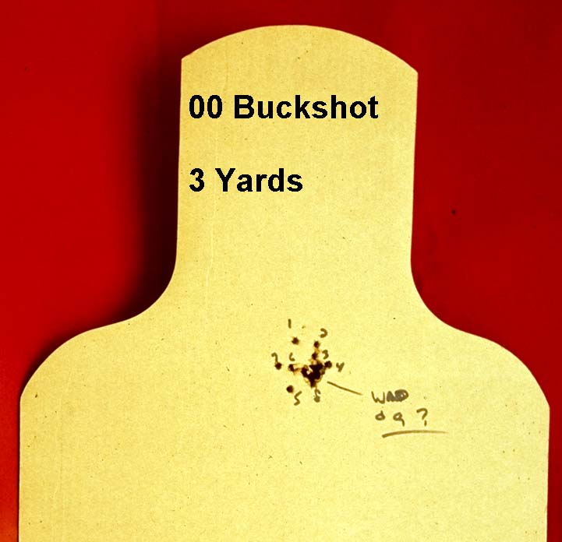
00 bk, 3 yds

Slide 16
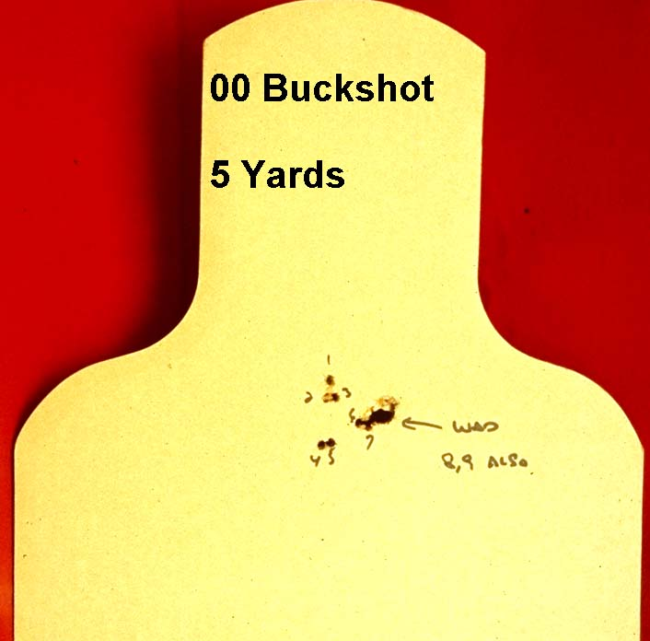
00bk, 5 yds

Slide 17
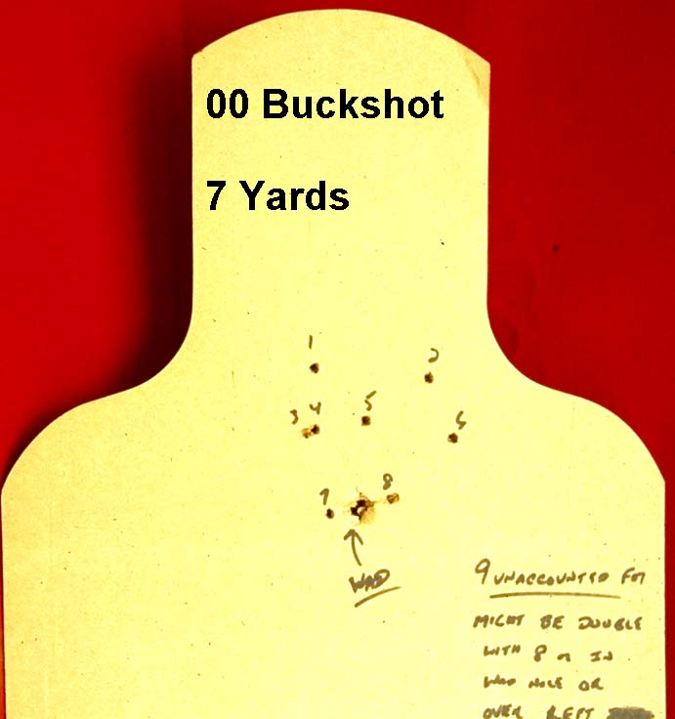
00 bk, 7 yds

Slide 18
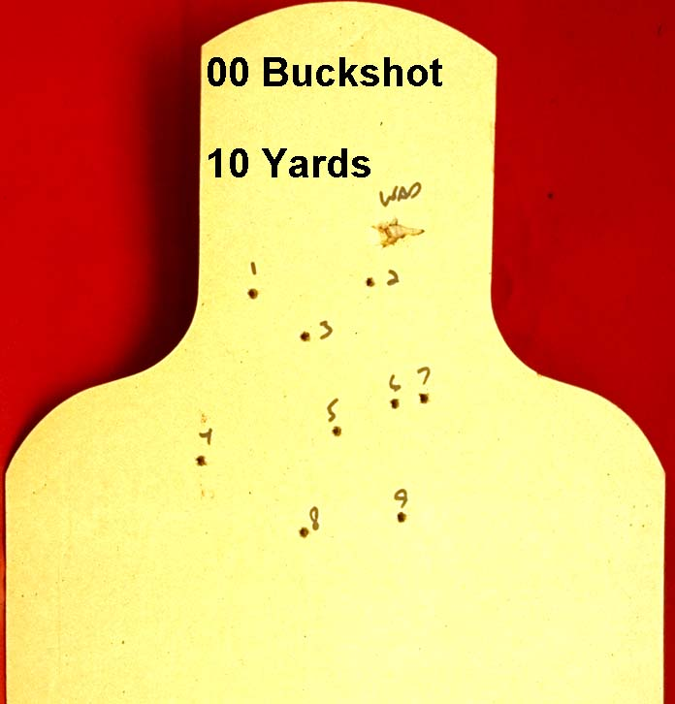
00 bk, 10 yds

Slide 19
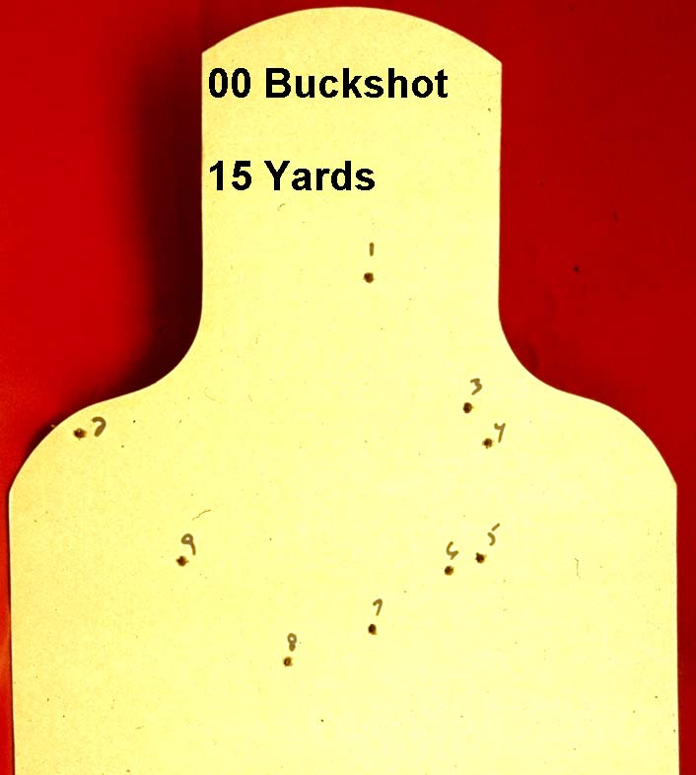
00 bk, 15 yds

Slide 20
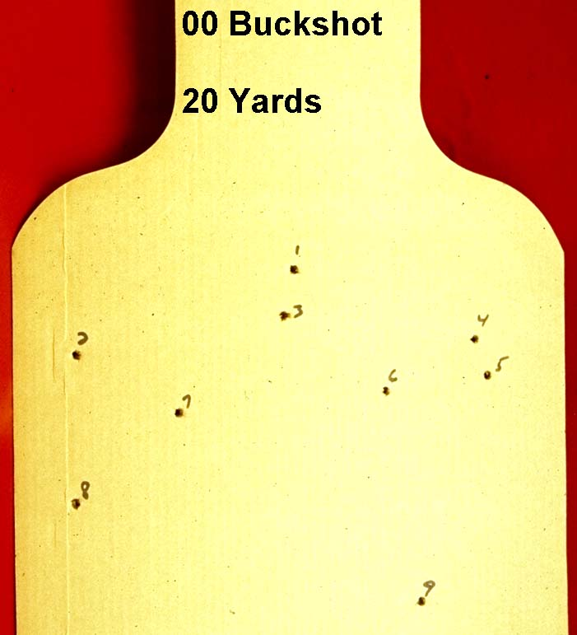
00 bk, 20 yds

Slide 21
00 bk, 25 yds

Slide 22
Buckshot Pattern Rule of Thumb
One inch of spread for every yard of travel

Slide 23
Nomenclature

Slide 24
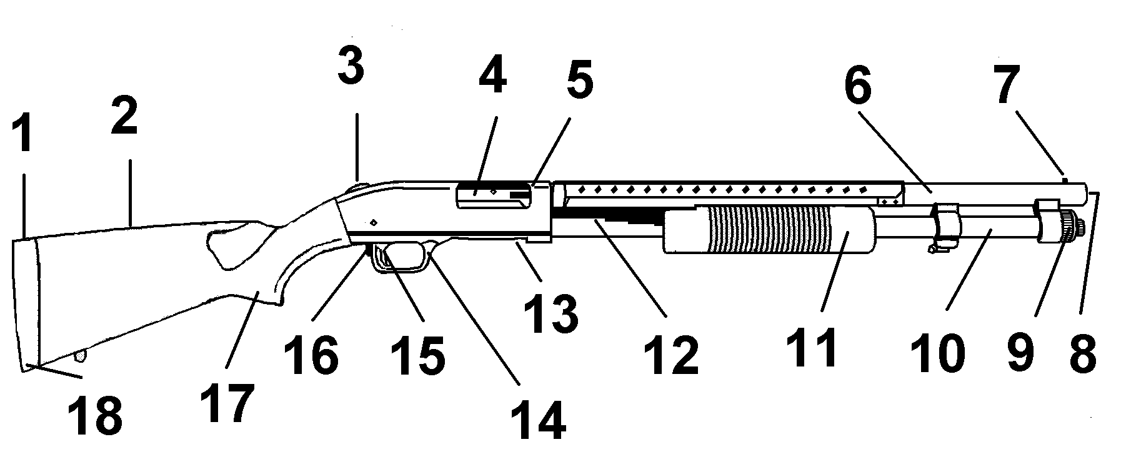
1. Heel (of stock) 7. Front Sight 13. Loading Port
2. Comb (of stock) 8. Muzzle 14. Trigger Guard
3. Manual Safety 9. Magazine End Cap 15. Trigger
4. Breechblock (Bolt) 10. Magazine 16. Action Release
5. Ejection Port 11. Forearm 17. Pistol Grip
6. Barrel 12. Action Bar(s) 18. Toe (of stock)

Slide 25
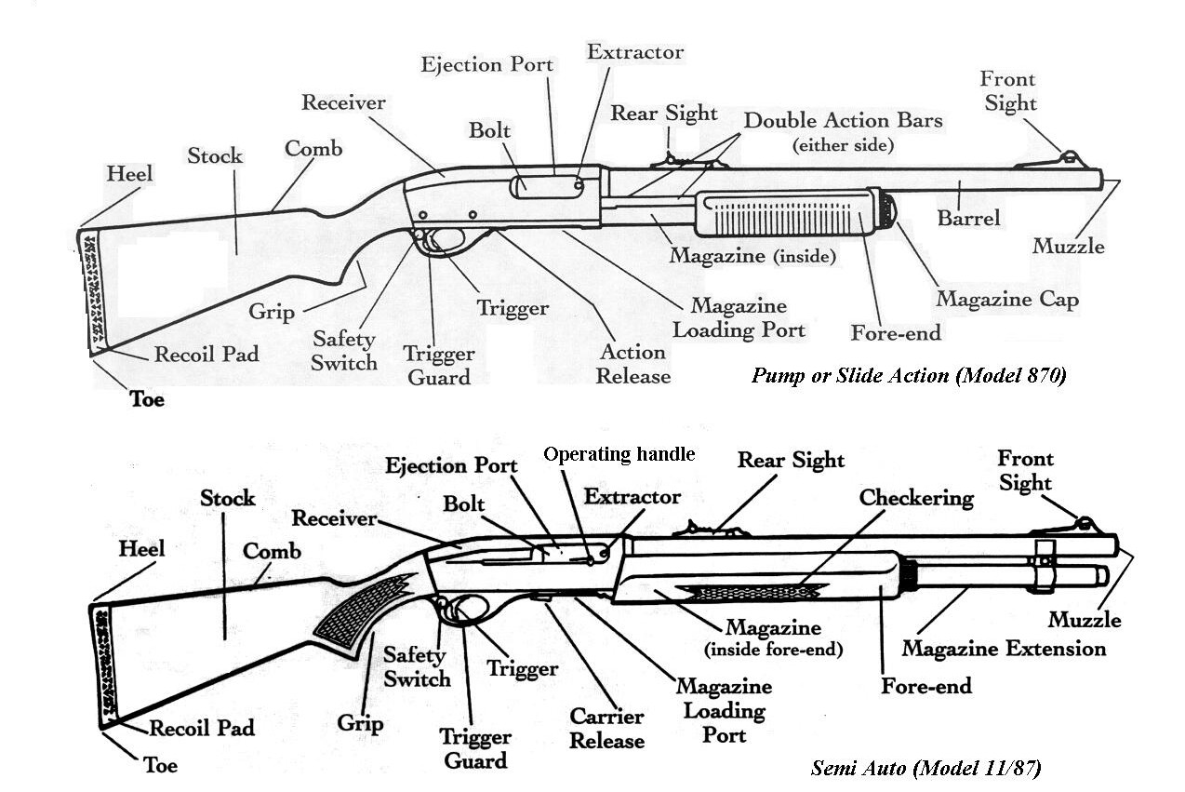

Slide 26
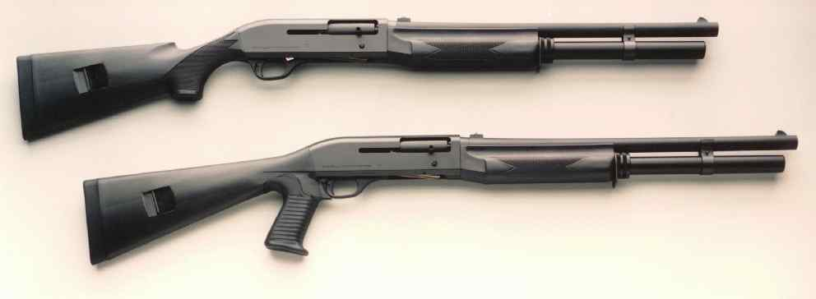
Semi-automatic - recoil operated Benelli

Slide 27
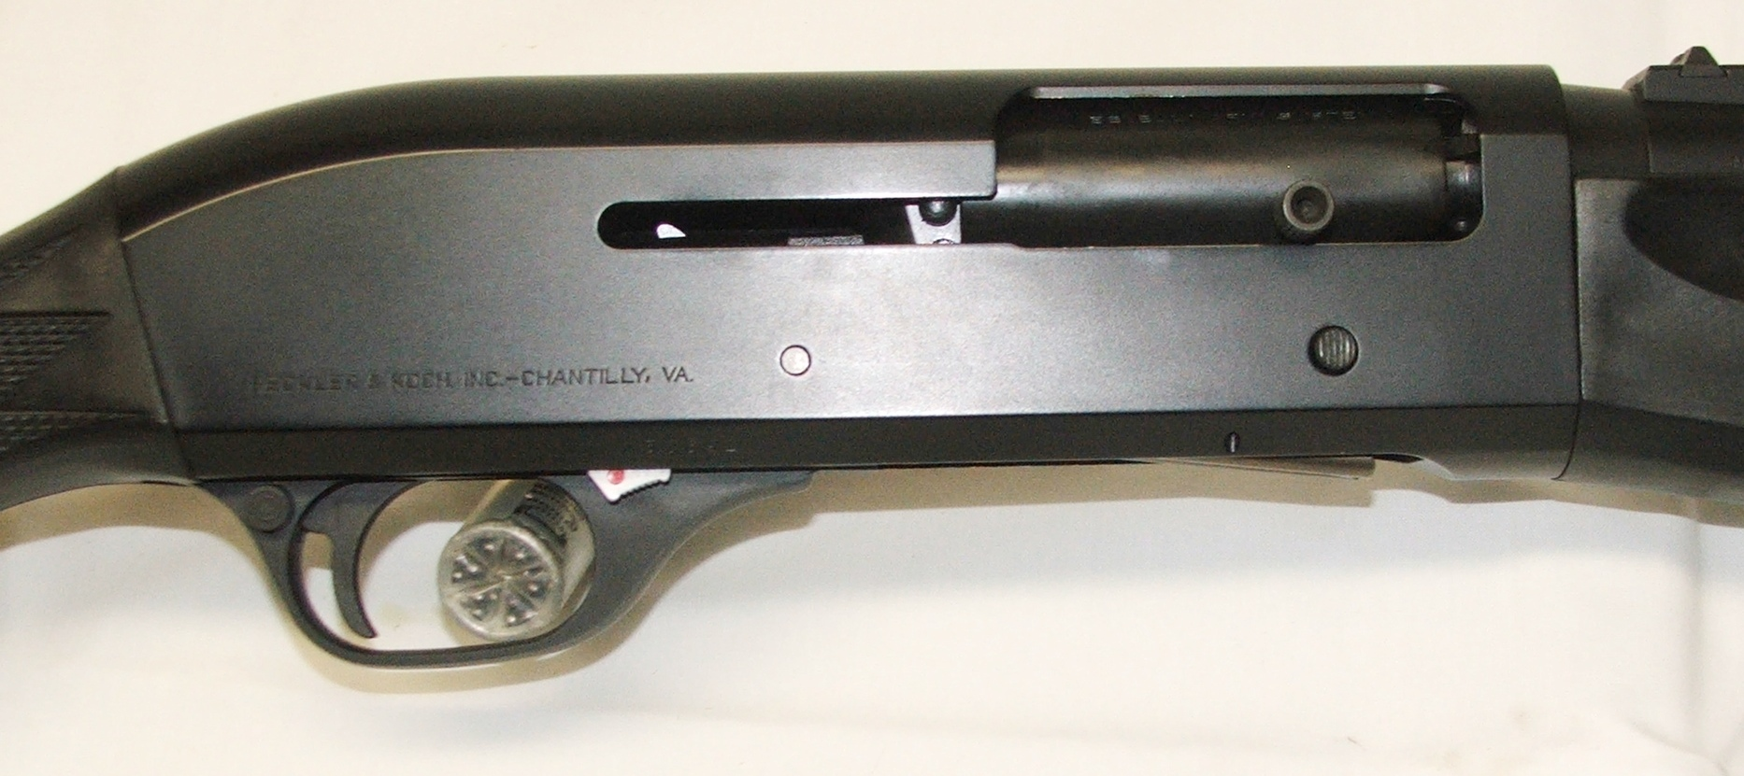
H&K / Benelli
Bolt Release Button
Cartridge Drop Lever
The red dot indicates the hammer is cocked

Slide 28
Cyclic Operation
FEED
FIRE
EXTRACT
EJECT

Slide 29
Cyclic Operation
FEED
FIRE
EXTRACT
EJECT

Slide 30
Cyclic Operation
FEED
FIRE
EXTRACT
EJECT

Slide 31
Cyclic Operation
FEED
FIRE
EXTRACT
EJECT

Slide 32
All Stoppages Will Fall Into One Of These Categories!

Slide 33
Fitting the Weapon to the Shooter

Slide 34
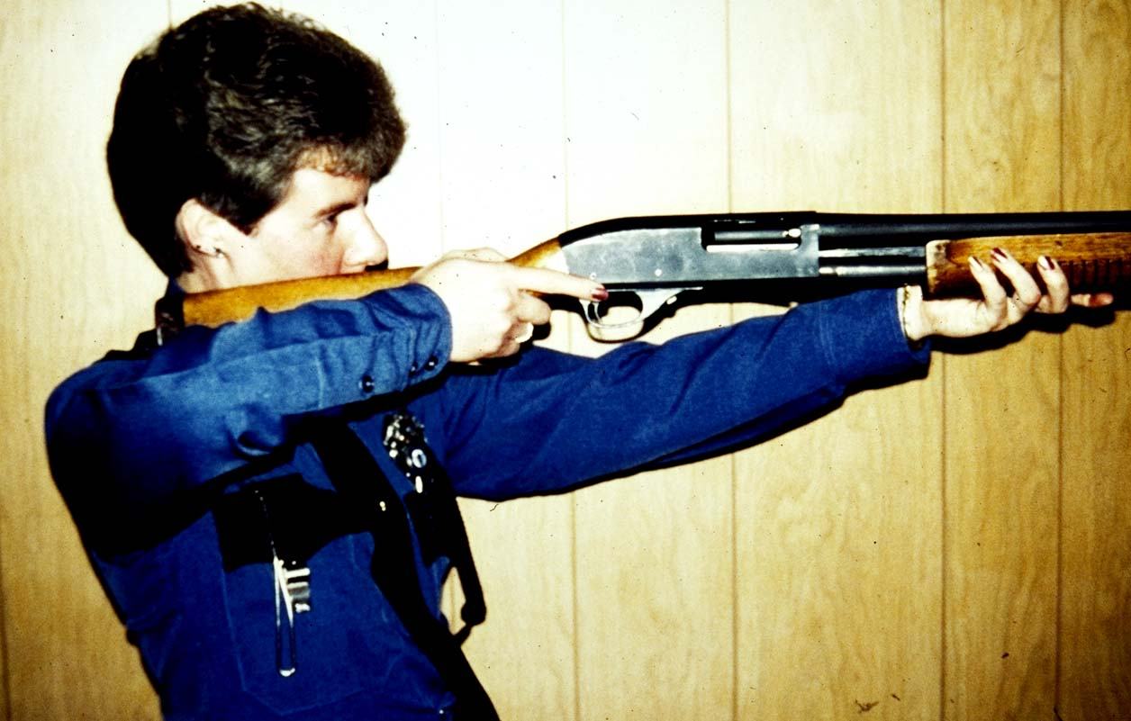
Standard stock
Places head to far back on the stock
Support arm fully extended

Slide 35
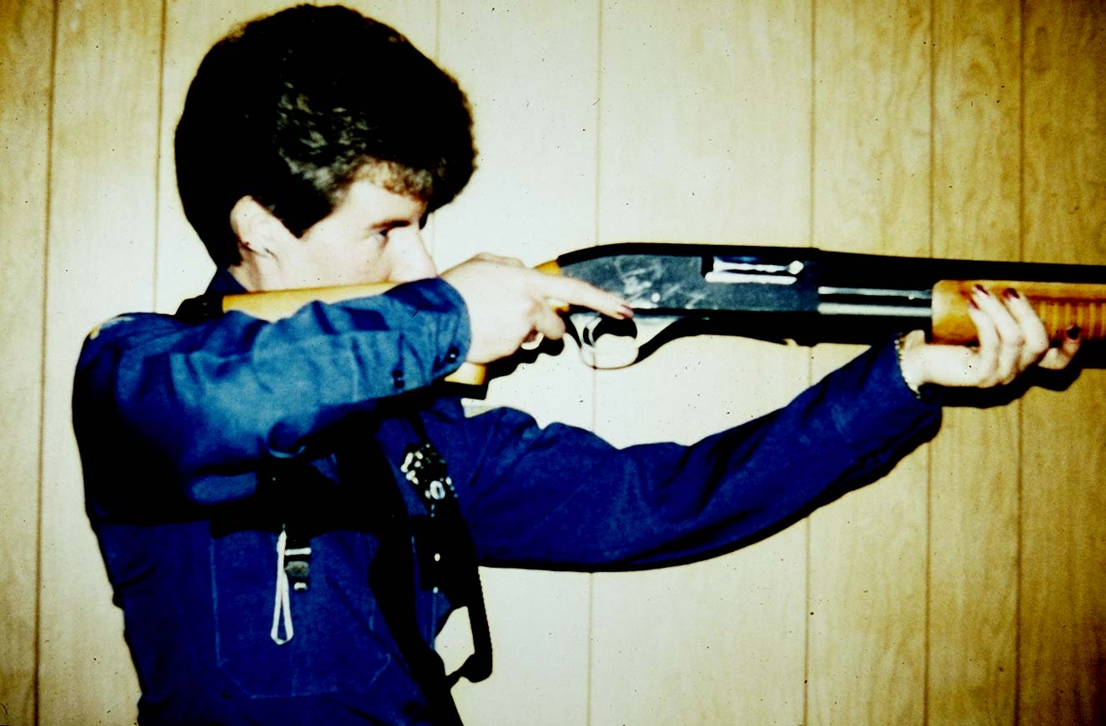
Youth or Tactical stock

Slide 36
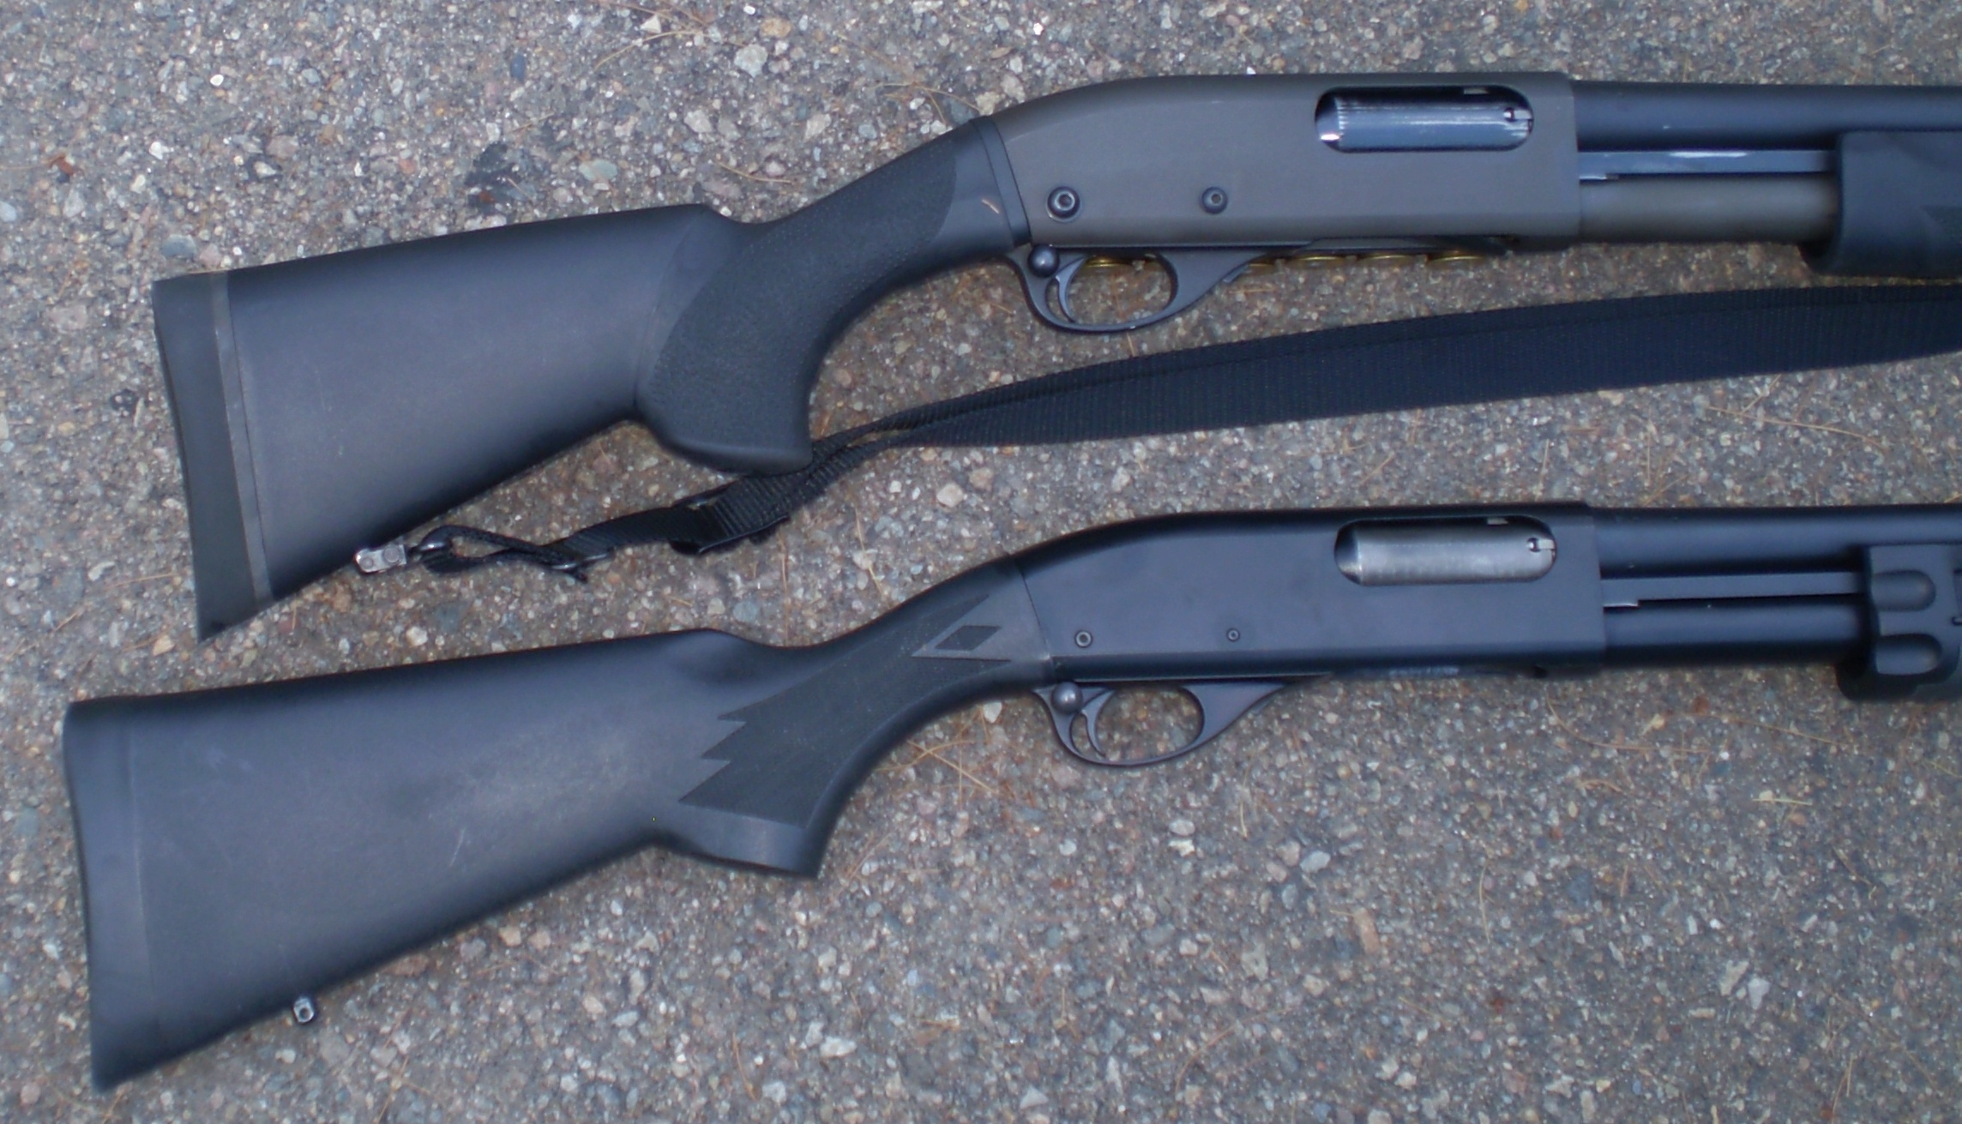
Comparison of stock lengths
TACTICAL
STANDARD

Slide 37
Here Is Another Way
Adapter permits an M4 collapsible stock and pistol grip to replace the conventional stock

Slide 38
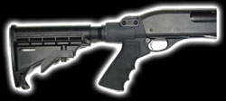
The adjustable stock permits changing the length of pull to
meet the needs of smaller officers and those with body armor.
M-4 stocks are available in 4 and 6 position versions.

Slide 39
Shotgun Fundamentals

Slide 40
Pump Shotgun Basics
Press
Back
Release
Forward

Slide 41
Pump Shotgun Basics
Press
Back
Release
Forward

Slide 42
Pump Shotgun Basics
Press
Back
Release
Forward

Slide 43
Pump Shotgun Basics
Press
Back
Release
Forward

Slide 44
Shotgun Fundamentals
Grip, Stance, Sights
&
Trigger Control

Slide 45
GRIP
Shotgun is a two handed tool
Firm hold on pistol grip and fore-end
Toe of stock in shoulder pocket
Proper stock to body contact critical - Prevents bruising

Slide 46
STANCE
Critical to proper and efficient operation - especially with smaller officers
Recoil (especially w/magnum loads)
Proper positioning necessary for rapid follow up shots - Bladed stance, knees flexed - Lean into the shot

Slide 47
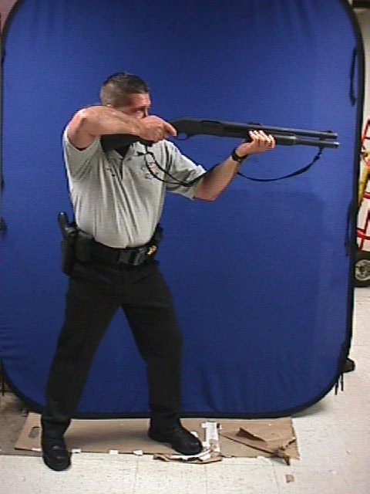
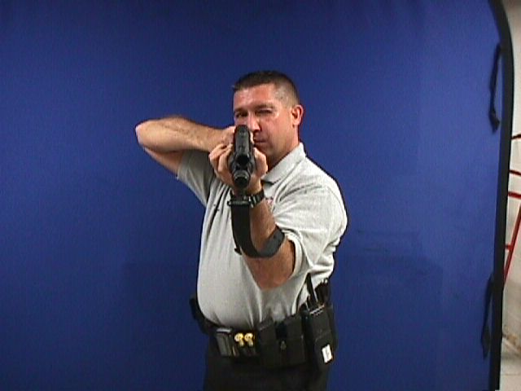

Slide 48
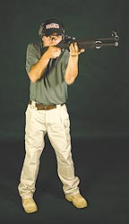
HK Stance
Note how the elbows are
tucked in close to torso
Stance is less bladed

Slide 49
SIGHT PICTURE

Slide 50
Sights
Rifle – use just like handgun sights
Bead – single ball at muzzle
Ghost Ring – rear aperture with protected blade front

Slide 51
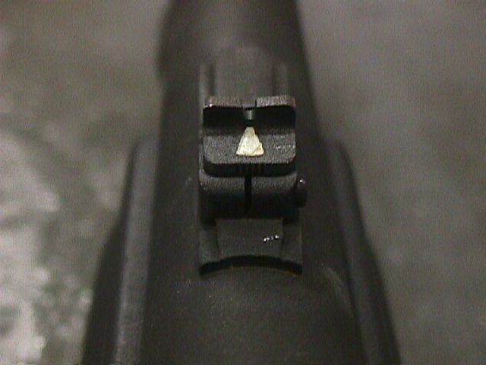
Rifle Type Sights
Front Rear

Slide 52
Rifle Sights

Slide 53
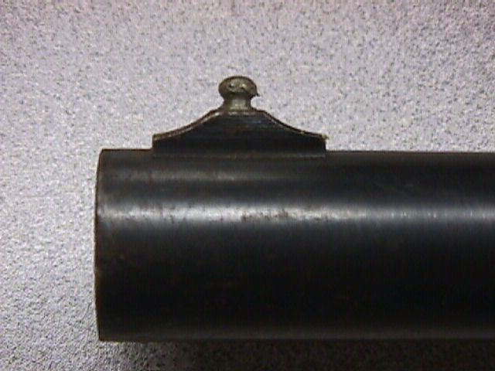
Raised Bead Front Sight

Slide 54
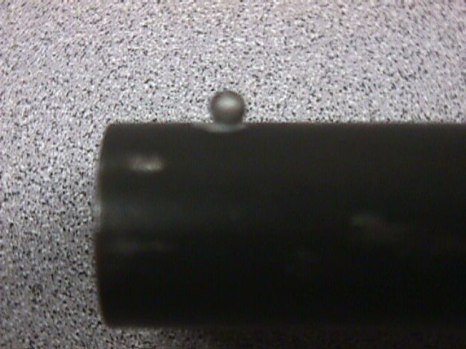
Bead Front Sight

Slide 55
Bead Sights Correct Sight Picture

Slide 56
Bead Sights Incorrect Sight Picture

Slide 57
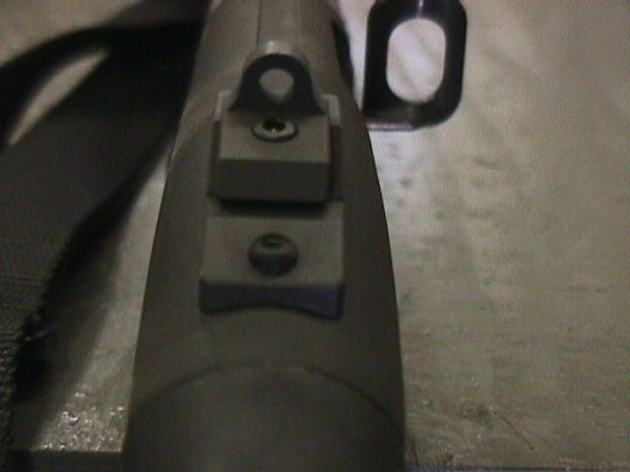
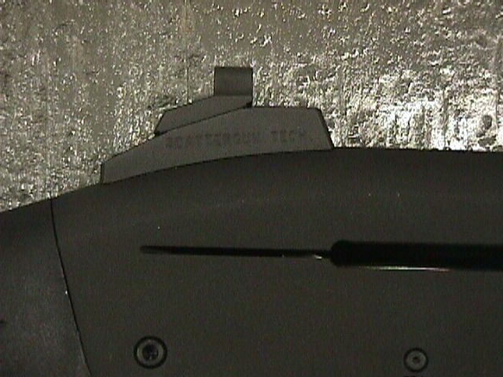
Ghost Ring Rear Sight
Looking forward Side View

Slide 58
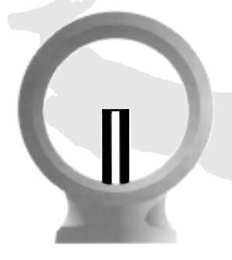
Ghost Ring

Slide 59
Trigger Control
Single Action trigger (Mossberg has a DA)
Press straight back
Be sure to release trigger after shot

Slide 60
The EASIEST mounting procedure to teach the novice with the shotgun is from the Low Ready

Slide 61
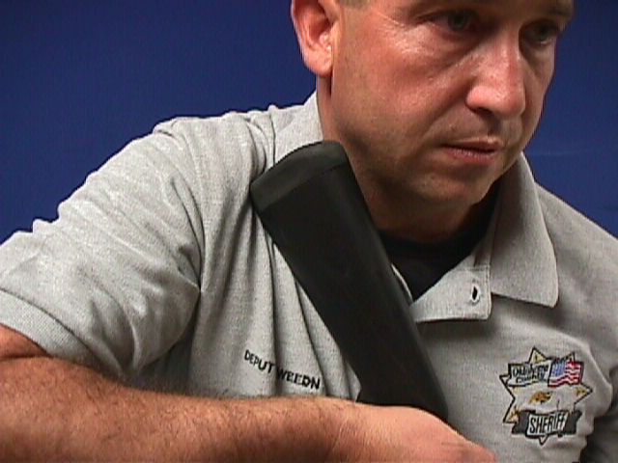
LOW READY POSITION

Slide 62
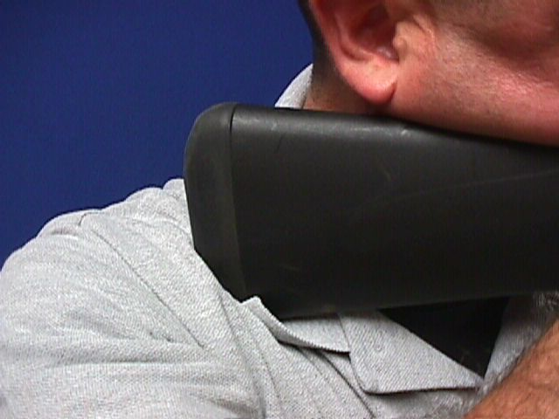
STOCK MOUNTING

Slide 63
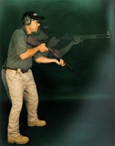
MOUNTING
Roll the shotgun up to your line of sight.
Keep your head up
The shotgun comes up to your eyes – not the other way

Slide 64
Shotgun Carry Condition Chart
F
I
N T
G R
E I
R G
G
O E
F R
F
Unloaded Action Open, Chamber Empty
Condition Magazine Empty
Safety "ON"
Transport Action Closed, Chamber Empty
Condition Loaded Magazine,
(Admin) Safety "ON"
Tactical Action Closed, Loaded Chamber,
Condition Magazine Full
Safety "ON"
Firing Action Closed, Loaded Chamber,
Condition Magazine Full
Safety "OFF"

Slide 65
UNLOADED
Long term safe storage
In designated loading area, safety ON;
Confirm magazine and chamber EMPTY
Close action
Double check safety ON
Secure weapon

Slide 66
Shotgun Carry Condition Chart
F
I
N T
G R
E I
R G
G
O E
F R
F
Unloaded Action Open, Chamber Empty
Condition Magazine Empty
Safety "ON"
Transport Action Closed, Chamber Empty
Condition Loaded Magazine,
(Admin) Safety "ON"
Tactical Action Closed, Loaded Chamber,
Condition Magazine Full
Safety "ON"
Firing Action Closed, Loaded Chamber,
Condition Magazine Full
Safety "OFF"

Slide 67
TRANSPORT LOAD
aka Administrative Mode or “Cruiser Carry”
In designated loading area, safety ON;
Confirm EMPTY, Close action
Load rounds in magazine
Double check safety ON
Secure weapon

Slide 68
Shotgun Carry Condition Chart
F
I
N T
G R
E I
R G
G
O E
F R
F
Unloaded Action Open, Chamber Empty
Condition Magazine Empty
Safety "ON"
Transport Action Closed, Chamber Empty
Condition Loaded Magazine,
(Admin) Safety "ON“
Tactical Action Closed, Loaded Chamber,
Condition Magazine Full
Safety "ON"
Firing Action Closed, Loaded Chamber,
Condition Magazine Full
Safety "OFF"

Slide 69
TACTICAL LOAD
Make weapon ready for threat confrontation
Remove from rack, muzzle in safe direction
Depress action lock, rack action fully to rear
Release action lock, close action fully
Weapon now has round chambered and can be fired after safety is disengaged

Slide 70
Shotgun Carry Condition Chart
F
I
N T
G R
E I
R G
G
O E
F R
F
Unloaded Action Open, Chamber Empty
Condition Magazine Empty
Safety "ON"
Transport Action Closed, Chamber Empty
Condition Loaded Magazine,
(Admin) Safety "ON"
Tactical Action Closed, Loaded Chamber,
Condition Magazine Full
Safety "ON"
Firing Action Closed, Loaded Chamber,
Condition Magazine Full
Safety "OFF"

Slide 71
FIRING MODE
When the decision to employ deadly force has been made
Safety OFF
Sights lined up on target
Double check what is behind target
Finger ON trigger when on target
Fire if necessary

Slide 72
TACTICAL RELOAD
To replace rounds expended in gunfight “Replace what you shot” “Top Off”
Finger OFF trigger
Performed with support hand
Best performed behind cover
Stay focused on threat, not on reload

Slide 73
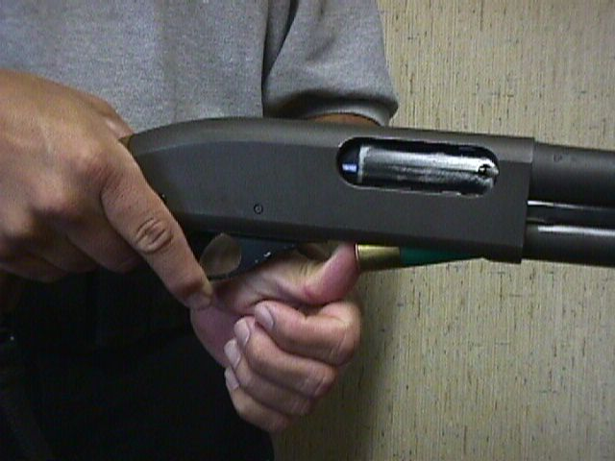
TACTICAL RELOAD
Replace what you shoot!

Slide 74
EMERGENCY RELOAD
aka “Combat Reload or Combat Load”
Performed when shotgun is shot dry
Action is left open, depress muzzle
Support hand drops 1 round into ejection port
Close action and fire if necessary
Finish reloading by Topping Off

Slide 75
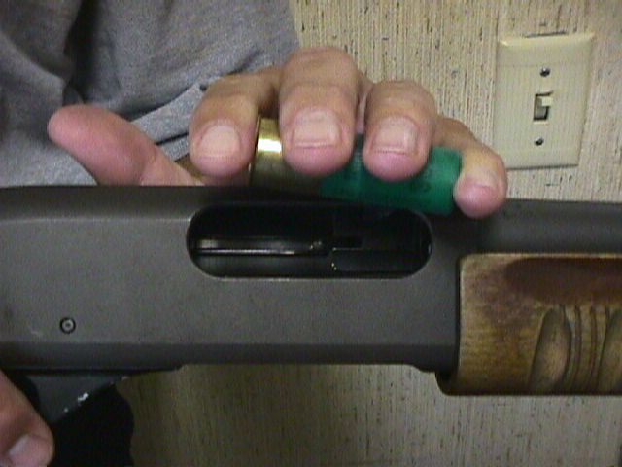
EMERGENCY RELOAD

Slide 76
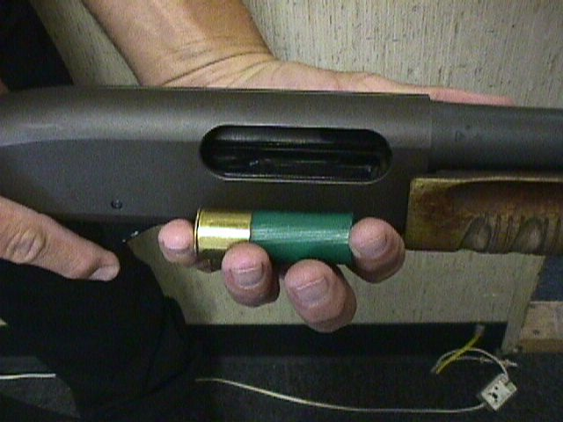
EMERGENCY RELOAD 2

Slide 77
ADMINISTRATIVE DOWNLOAD Pump Shotguns
Safe direction, safety ON, clear of bystanders
With off hand over ejection port, open action
Catch and pocket round as it ejects
Roll shotgun to dump next round into hand
Pocket round and check for empty chamber
Close action
Reload the 2 rounds into the magazine

Slide 78
ADMINISTRATIVE DOWNLOAD Benelli Semi-Auto Shotguns
Safe direction, safety ON, clear of bystanders
Pull bolt handle to rear
Pick round off extractor
Close action
Reload the round into the magazine

Slide 79
ADMINISTRATIVE DOWNLOAD Remington Semi-Auto Shotguns
Safe direction, safety ON, clear of bystanders
Pull bolt handle to rear
Pick round off extractor
Close action
Reload the round into the magazine

Slide 80
UNLOADING PROCEDURE
To completely empty the shotgun
Safe direction, safety ON
Perform all steps in Download except reloading back to magazine
Manipulate shell latches to release rounds in magazine one at a time
Double check for empty chamber
Visually confirm empty chamber & magazine

Slide 81
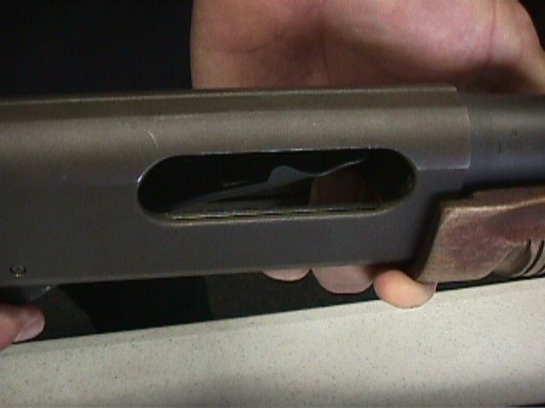
Double Check - Chamber Is EMPTY

Slide 82
Key Accessories
Sling
Spare Ammo
Light

Slide 83
QUESTIONS?

